Slide 1
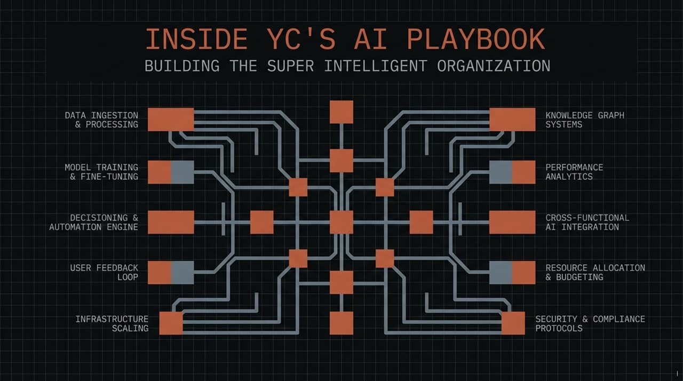
Notes:
https://www.youtube.com/watch?v=B246K_G7mHU
Welcome, everyone. Today we’re lifting the curtain on how Y Combinator has transformed itself from the inside out. While YC is known for funding the world's leading AI startups, what many don't realize is that internally, we’ve been building and operating on our own custom AI agent infrastructure.
We aren't just giving our teams off-the-shelf copilots. We’ve built a shared organizational brain—an interconnected substrate where every process, transcript, decision, and tool is linked into a unified, self-improving system. Over the next few minutes, we’re going to walk through the architecture, the cultural shifts, and the exact playbook we used to achieve this.

Slide 2
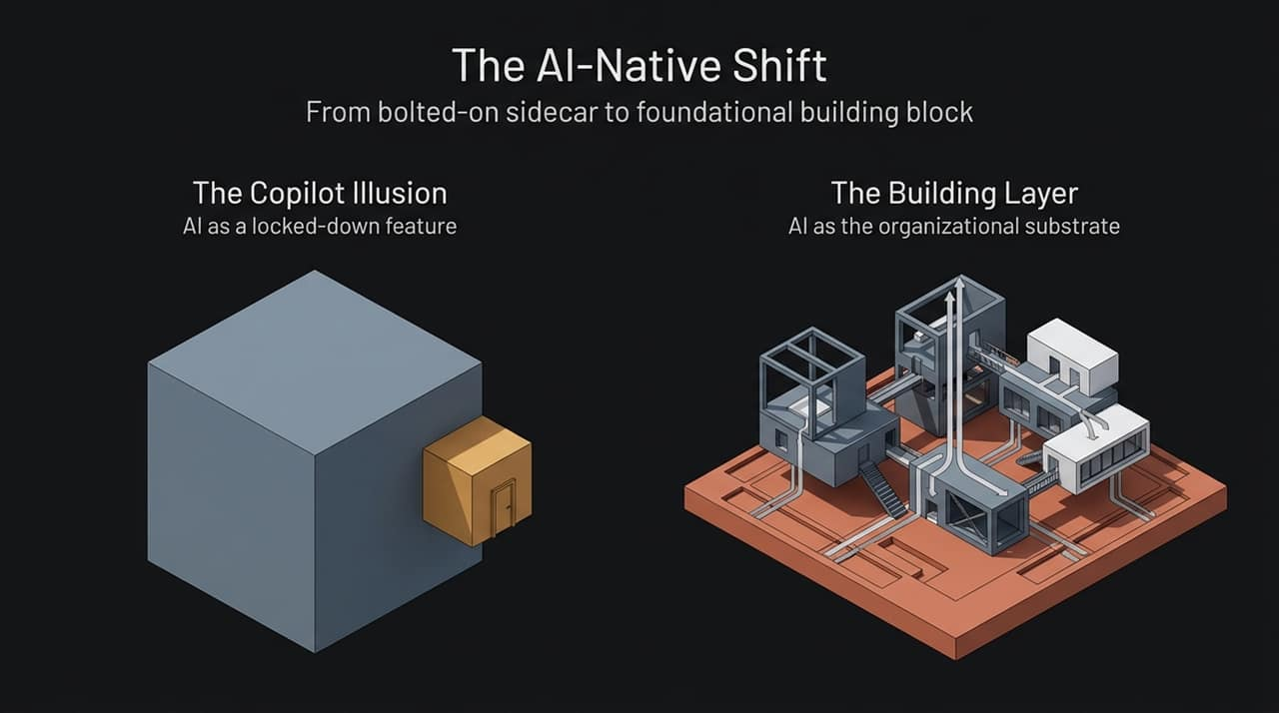
Notes:
Most companies approaching AI today fall into what we call 'The Copilot Illusion'. They take legacy software, slap an AI chatbot or a sidecar button onto the UI, and call it an AI transformation. That’s the small box bolted onto the side of the building.
An AI-Native Shift requires AI to be the structural building layer of the entire company. Instead of asking, 'Where can we plug AI into our existing app?', the question becomes, 'How do we make AI the core substrate upon which all workflows and communication flow?' When you shift from a bolted-on feature to an architectural layer, AI ceases to be just an assistant—it becomes the collective intelligence of the entire team.

Slide 3
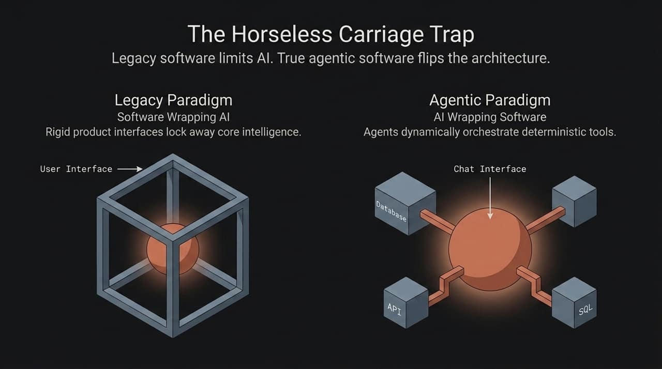
Notes:
When cars were first invented, people called them 'horseless carriages' and designed them like horse buggies with an engine attached. The software industry is making the exact same mistake right now.
Under the Legacy Paradigm, developers build rigid software UIs and hide the AI inside a narrow, locked-down box. Think of the early Gmail email writer—you couldn't see or change the underlying prompt context. Developers kept all control and protected the user from 'complexity'.
In the Agentic Paradigm, we completely flip the stack. AI wraps the software. The agent acts as the primary interface, while databases, APIs, and SQL tools become deterministic execution units that the agent calls dynamically on demand.

Slide 4
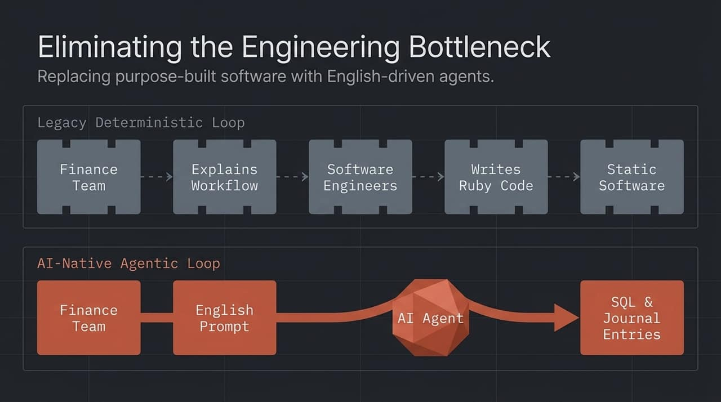
Notes:
This slide illustrates the origin story of YC's internal agent harness. About a year ago, Pete Koomen and our engineering team sat down with YC's finance team to build tools for booking journal entries and tracking priced rounds.
In the old loop, the finance team explained a complex workflow to engineers, engineers wrote thousands of lines of Ruby code, and handed back a static software tool. If the process changed, the loop started all over again—creating a massive engineering bottleneck.
We asked: What if we remove software engineers from this loop entirely? In the AI-Native loop, the finance team writes their intent in plain English prompts. The AI agent translates that intent directly into SQL queries and automated journal entries. Non-technical operators gain direct control over their own software execution.

Slide 5
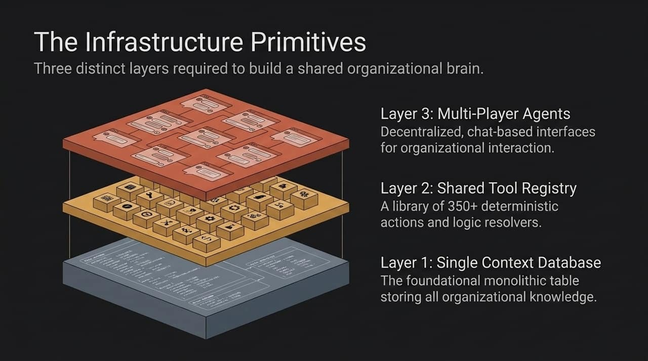
Notes:
To replicate this setup in your own organization, you need three foundational primitives:
Layer 1: Single Context Database. An agent is only as smart as its context. Having a single, centralized database containing all key company entities gives the agent complete visibility across your operations.
Layer 2: Shared Tool Registry. At YC, we started with 20 basic tools, and today we have over 350. Every team encodes their operational logic into reusable action functions.
Layer 3: Multi-Player Agents. Most popular frameworks (like Cursor or Claude Code) are single-player, local-machine tools. True leverage happens in a multi-player harness where agents communicate in shared channels and collaborate across entire teams.

Slide 6
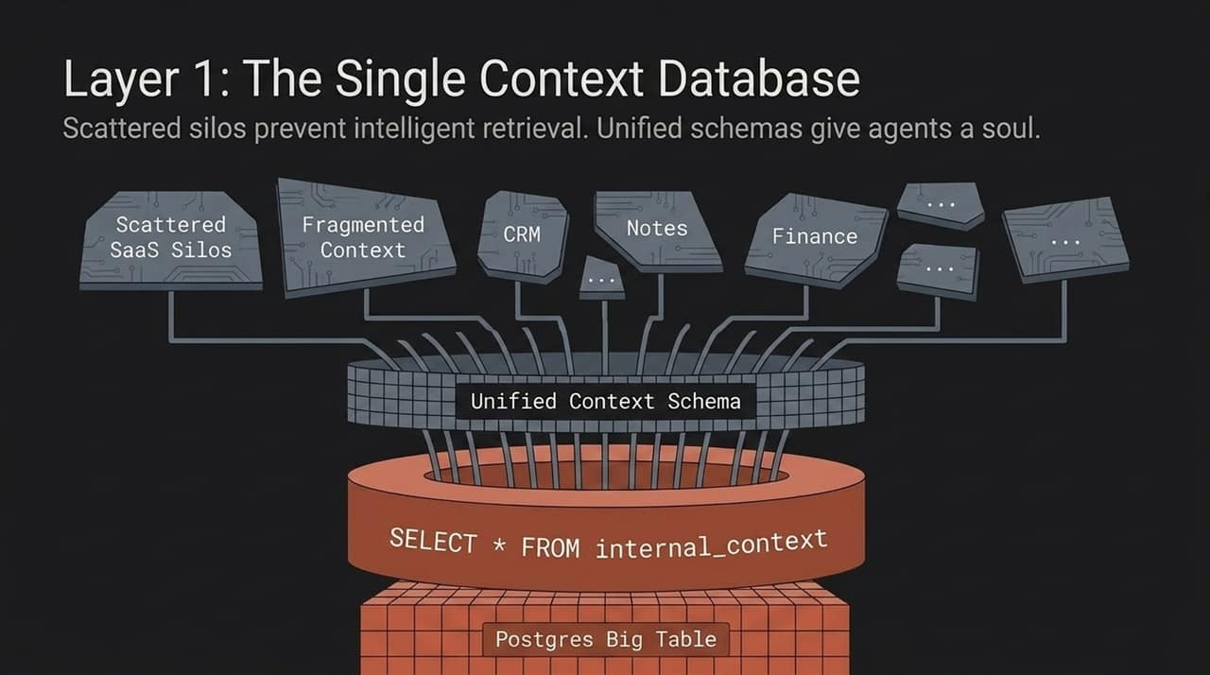
Notes:
Why was YC uniquely positioned to succeed with agents so quickly? Because historically, YC built its own internal software on a single monolithic Postgres database. Companies, founders, financial transactions, and office hour notes all live in one place.
Most modern companies have context scattered across dozens of isolated SaaS silos. When your data is fragmented, an agent cannot answer questions like, 'Show me all space startups funded in the last four batches alongside investor notes.'
You must unify and denormalize your corporate data into a consolidated context layer. When an agent has full context, query time drops from hours of manual SQL writing to seconds—triggering Jevons' Paradox: as the cost of asking complex business questions falls to zero, the volume and depth of questions you dare to ask skyrockets.

Slide 7
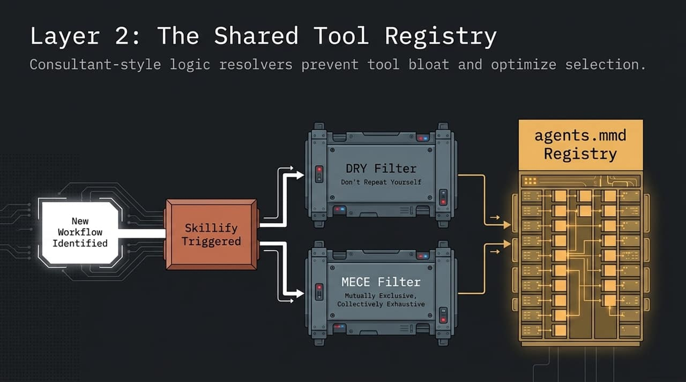
Notes:
As your team adds hundreds of custom tools, how do you prevent agent bloat and tool overlap? At YC, we use an automated pipeline called Skillify coupled with an intelligent resolver table.
When a new workflow is identified and 'skillified,' it passes through two critical filter layers before being registered:
DRY (Don't Repeat Yourself): Ensures we don't build ten overlapping skills that perform slightly different versions of the same task.
MECE (Mutually Exclusive, Collectively Exhaustive): A management consulting principle applied to agent architecture. Tools are designed with modular parameters so the agent's logic resolver can effortlessly choose the optimal tool for any task.

Slide 8
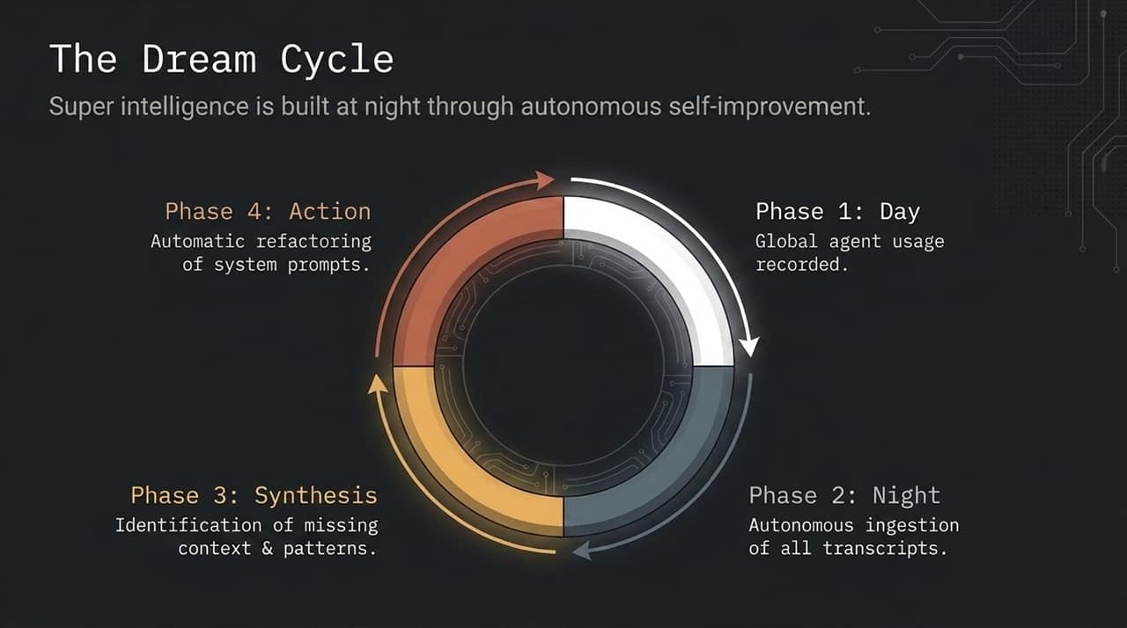
Notes:
Super-intelligence isn't static—it's built overnight while the team sleeps. Inspired by Karpathy’s 'Auto-Research' concepts and OpenClaw’s 'Dream Cycle,' YC runs an autonomous nocturnal feedback loop.
Phase 1 (Day): All agent interactions across the organization are recorded.
Phase 2 (Night): An autonomous meta-agent ingests all conversation transcripts from the day.
Phase 3 (Synthesis): The agent analyzes where human prompts failed, where missing context caused hallucinations, and where workflows were inefficient.
Phase 4 (Action): The system automatically refactors and updates system prompts and skill registries for the next morning.

Slide 9
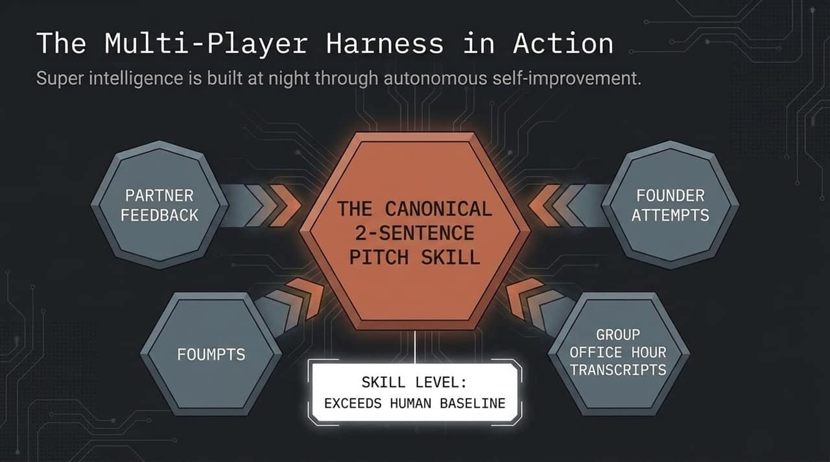
Notes:
Here is a concrete example of this in action: The 2-Sentence Pitch Skill. Teaching founders how to concisely explain what their company does is a core YC competency, honed over decades.
YC Partner Tom wrote an initial prompt skill for writing 2-sentence pitches. Then, partners hosted group office hours where founders attempted pitches and partners gave real-time critiques.
We fed those meeting transcripts directly back into the meta-agent loop. By ingesting decades of collective partner instinct captured in those transcripts, the agent refactored the skill. Today, that skill writes 2-sentence pitches better than any individual partner on the team—effectively scaling institutional tacit knowledge.

Slide 10
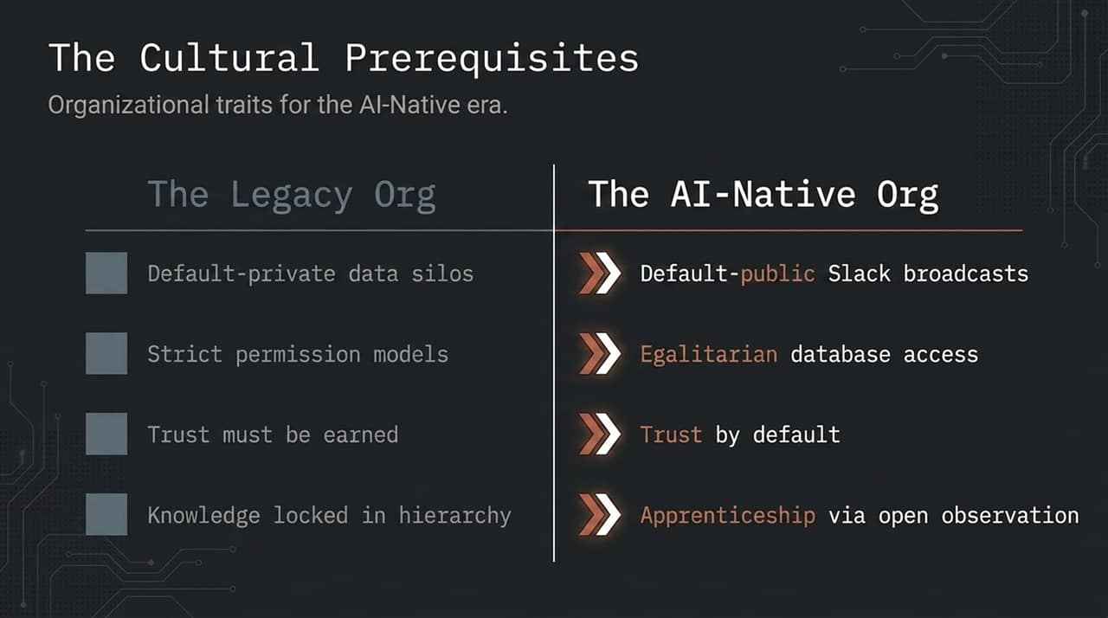
Notes:
Dario Amodei and others have pointed out that the rate of AI progression in organizations is rarely hindered by technology—it is blocked by culture.
Legacy organizations operate on private data silos, strict permissions, and defensive security postures. But agents require broad context to perform at an elite level.
At YC, we adopted two key cultural principles:
Default-Public Broadcasts: Every agent interaction is automatically streamed to a shared internal Slack channel. This creates social accountability while letting the entire team learn prompt strategies via open observation.
Trust by Default & Egalitarian Access: Everyone, from junior hires to general partners, gets access to the unified context layer. This dramatically raises the organizational floor, allowing new employees to ramp up in weeks instead of months.

Slide 11
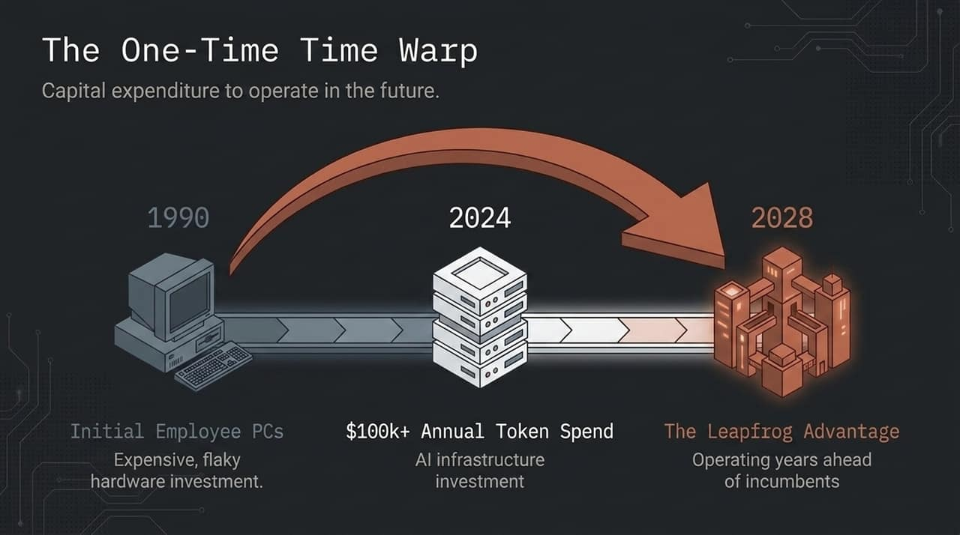
Notes:
In 1990, buying expensive personal computers for every employee felt like a massive risk. Today, spending $100,000+ per year on AI token costs might raise eyebrows in a traditional finance committee.
But token expenditure is a One-Time Time Warp. What costs $100,000 in tokens today will cost $10,000 in two years and $100 in four years. By spending heavily on tokens today, you buy your organization the ability to operate in 2028 right now. It’s a leapfrog advantage that legacy incumbents stuck in cost-cutting mindsets cannot match.

Slide 12
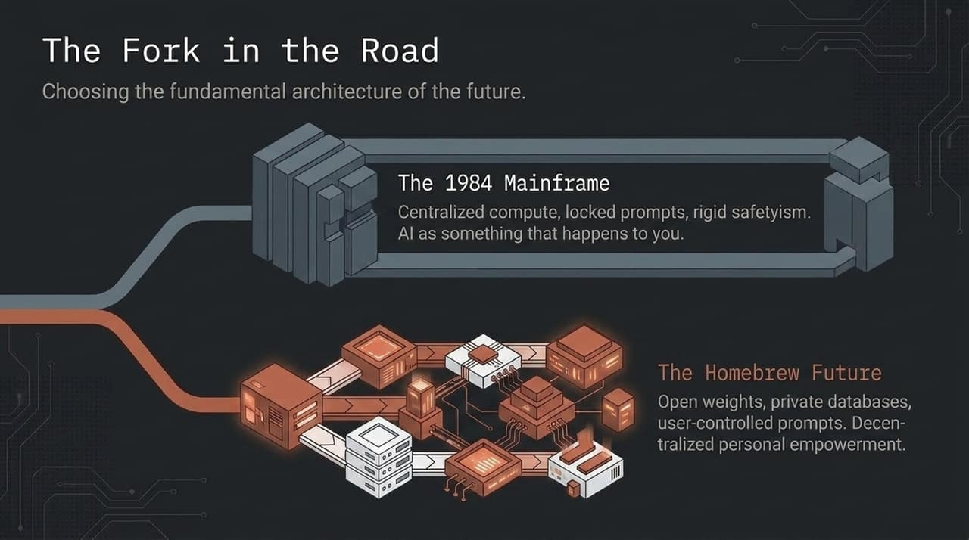
Notes:
We stand at a critical strategic fork in the road, reminiscent of the 1984 Apple Macintosh moment.
On one side is The 1984 Mainframe Path: Centralized corporate kings, locked-down UIs, hidden system prompts, and heavy safetyism where AI is something that happens to you.
On the other side is The Homebrew Future: Inspired by the Homebrew Computer Club that birthed the PC revolution. This path embraces open-weight models, customizable agent harnesses, private databases, and full user control. We firmly believe that organizations embracing the Homebrew approach will unlock vastly superior creativity and leverage.

Slide 13
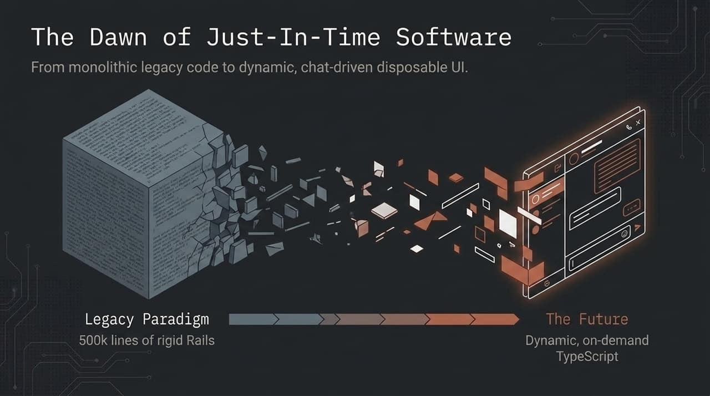
Notes:
Gary Tan recently recounted spending weeks writing 500,000 lines of Rails code to build a complex agentic research tool. In hindsight, building massive, rigid monolithic software in 2026 is an artifact of the past.
We are entering The Dawn of Just-In-Time Software. The best AI systems (like Boris Cherny's Claude Code or open-source tools like Pi) are intentionally tiny. You maintain a minimal core, and the agent dynamically generates disposable UIs, single-page scripts, and on-demand TypeScript execution tailored to the user's exact momentary context.

Slide 14
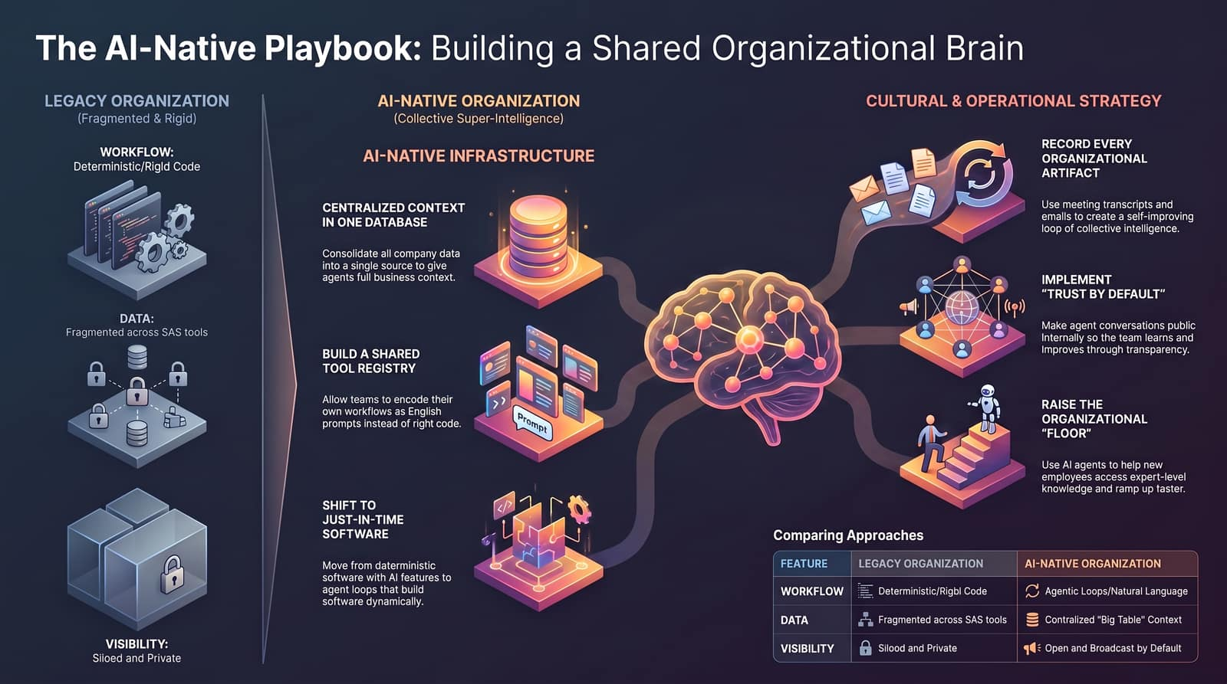
Notes:
To wrap up, let's review the definitive playbook comparing where traditional companies are versus where AI-Native organizations operate:
Feature Legacy Organization AI-Native Organization
Workflow
Rigid, deterministic code
Natural language agentic loops
Data
Fragmented SaaS silos
Centralized 'Big Table' context
Visibility
Siloed and private
Open & broadcast by default
Software Strategy
Built-ahead static software
Dynamic, Just-In-Time software
Culture
Need-to-know permissions
Trust-by-default, fast ramp-up
Building super-intelligence isn't magic. It comes down to recording every artifact, building a shared tool registry, consolidating your context, and empowering your people to program their workflows in plain English. Thank you!"

